Slide 1

VISVESVARAYA TECHNOLOGICAL UNIVAERSITY “JNANASANGAMA”,BELAGAVI-590018
K R PETE KRISHNA GOVERNMENT ENGINEERING COLLEGE,KR PET-571426
2023-2024
Department of Computer Science & Engineering
Project Phase-1 Presentation On
“Enhanced Technique to Assist Visually Impaired and Blind people”
Presenting By
B V DISHA 4GK20CS004
SOWMYA B 4GK20CS031
THIPPEGOWDA B M 4GK20CS039
KAVANA S P 4GK21CS406
Under the Guidance of Head of the Department
Dr. Nagappa U Bhajantri Dr. Hareesh K
Professor Associate Professor &HOD
Dept of CS&E Dept of CS&E

Slide 2
Contents
Abstract
Introduction
Literature Survey
Motivation and Challenges
Existing System and Drawbacks
Proposed System
Problem Statement
Objectives
Applications Of The Project
System Architecture with its module
System Requirements
Conclusion and Future Scope
References

Slide 3
Abstract
The “Enhanced Techniques to assist Visually Impaired and Blind People” is a cutting-edge technological solution aimed at empowering visually impaired individuals to navigate their surroundings with greater autonomy and safety.
The main aim of this project is to represent a significant leap in assistive technology, promising greater independence and safety for visual impairants and blind people.
Mentioned technology is implemented using Machine Learning and image processing techniques.
DEPT OF CS&E

Slide 4
Introduction
There are thousands of technologies being developed or have been developed for the assistance of blind people. Computer vision being one of these technologies is providing the most promising solute.
Blind people find hard time while navigating and reading books or any text. Due to their inability to see world ,they are often in danger of getting hit by obstacle and vehicle and not able to read all books.
For visually impaired people to be able to provide, experience their vision, imagination mobility is necessary.
DEPT OF CS&E

Slide 5
Continued…
With the advancement in technologies, diverse solutions have been introduced such, as the Eye- ring project, the text recognition system, the hand gesture, and face recognition system, etc.
However, these solutions have disadvantages such as heavyweight, expensive, less robustness, low acceptance, etc. hence, advanced techniques must evolve to help them.
So, we propose a system built on the break through of image processing and machine learning.
DEPT OF CS&E

Slide 6
Literature Survey
SL.NO | TITLE OF THE PAPER | AUTHORS | YEAR OF PUBLICATION | PROPOSED SYSTEM | OUTCOME
1. | “Reader and Object Detector for Blind” | 1.M Murali. 2.Shreya sharma. 3.Neel nagansuri. | 2020 | Text reading - OCR and TTS Synthesis. Object Detection-TensorFlow Object Detection API. | Detect various objects in its surroundings and provide an audio feedback.
2 | “Automatic Object Detection and Recognition to assist Blind People” | 1.Ervin yohannes. 2.Paul lin. 3.Chih-yang lin*. 4.Timothy k.shih. | 2020 | Using ZED stereo camera, a camera that can calculate depth information of object and can also capture the image of an object. | Achieves an accuracy rate of about 81%, which is better than naive YOLO v3.
DEPT OF CS&E

Slide 7
Literature Survey
SL. NO | TITLE OF THE PAPER | AUTHORS | YEAR OF PUBLICATION | PROPOSED SYSTEM | OUTCOME
3. | “Assisting Blind People Using Object Detection with Vocal Feedback” | 1.Heba najm 2.Khirallah Elferjni 3.Alhaam alariyibi. | 2022 | You Look Only Once (YOLO) model is utilized which is CNN-based real-time object detection technique along with Open CV and deep learning. | result was evaluated by using the mean Average Precision (mAP)
DEPT OF CS&E

Slide 8
Motivation and Challenges
The project's motivation lies in fostering inclusivity, independence, and accessibility, providing a valuable tool for individuals with visual challenges to navigate and access information in their daily lives.
So far there are efforts in this direction However, those are less competitive in terms of performance and friendliness. Hence we would like to extend our digital support the community need.
Mathematical model is complex and getting output accuracy is challenging factor.

Slide 9
Existing System And Drawbacks
Existing System :
Trained domestic animals like dogs
cleaver rehabilitative shoes
Enlarging Devices - Handled magnifiers
Braille - To read and write
Blind Sticks
DEPT OF CS&E

Slide 10
Drawbacks :
These existing devices like blind sticks can only detect obstacles after contact with object.
People cannot always relay on domastic animals.
These cannot differentiate between different kind of obstacles.
Books in braille languages are only readable by the blind, and it is exceedingly difficult for those with visual impairments to read at a distance.
DEPT OF CS&E

Slide 11
Proposed System
Our solution to the problem is to create a device which can recognise obstacle using camera. The design of module is small and compact also easy to carry.
This system will continuously record video of the surrounding and will convert it into frames.
After analysing these frames the system will alert the person about some obstacle or the surrounding.
DEPT OF CS&E

Slide 12
Problem Statement
User gets to know the obstacle in front of him when the stick touches the obstacle. But it cannot detect without object contact with the obstacle which sometimes is dangerous since we have to detect object bit farther away.
Blind people cannot read normal books since they cannot see ,they can only understand special books which are designed to blind but the problem is not every book is designed for blind people.
DEPT OF CS&E

Slide 13
Objectives
To build device which will be able to capture image of a book and identify the text and convert and play in audio format.
The device should be able to detect the object using camera and play the object name in speaker.
DEPT OF CS&E

Slide 14
Application of The Project
Assisting the Visually Impaired
Object Identification
Book Reading Accessibility
Inclusive Navigation
Educational Support
Hands-Free Interaction
Privacy-Preserving
Customization
User-Friendly Interface
DEPT OF CS&E

Slide 15
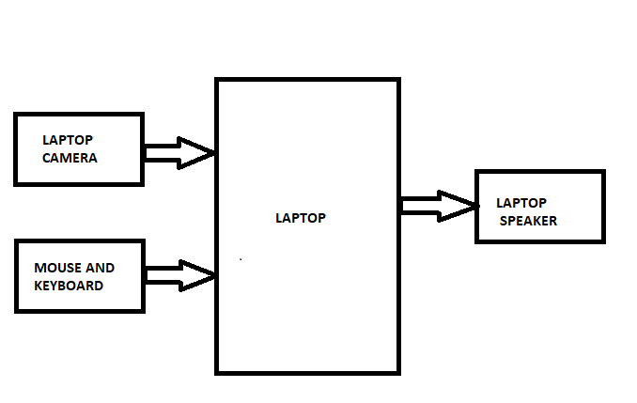
System Architecture Along With Its Modules
System Architecture:
Blind assistant system
DEPT OF CS&E

Slide 16
System Architecture Along With Its Modules
Modules:
Object Detection module
Book reading module
Image processing module
DEPT OF CS&E

Slide 17
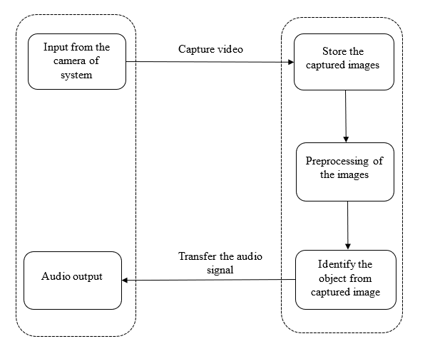
Flowchart For Object Detection Module
Object Detection Module
DEPT OF CS&E

Slide 18
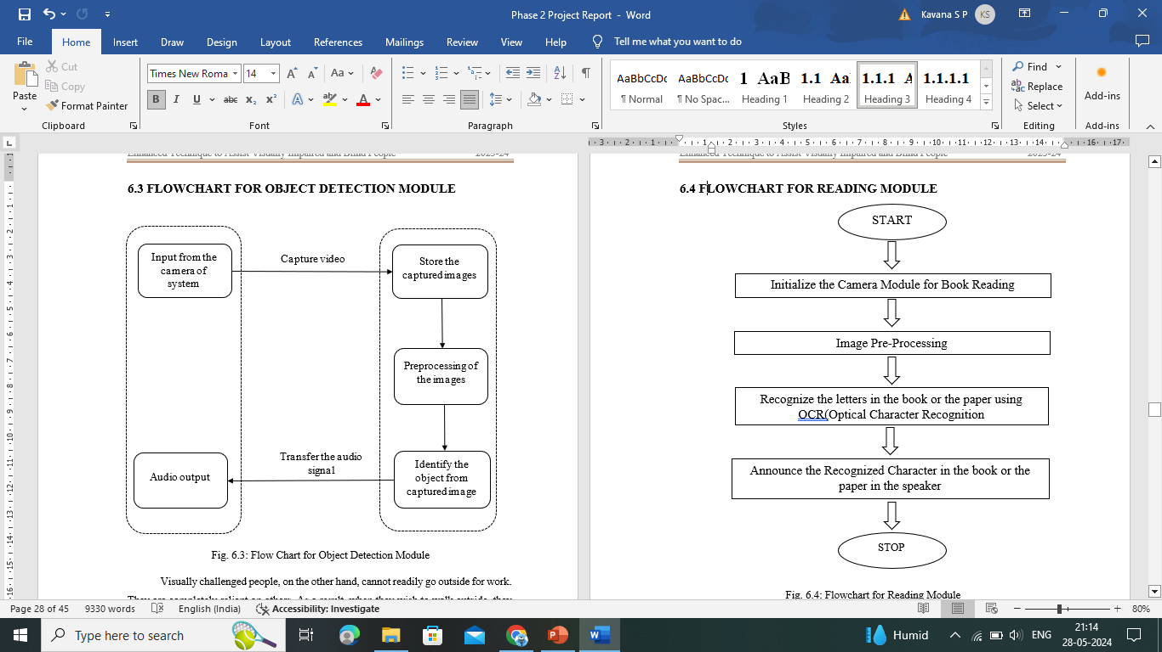
Flowchart For Reading Module
Reading Module
DEPT OF CS&E

Slide 19
Software Requirements:
System Requirements
Hardware Requirements:
System : Intel i5 or above
RAM : 8 GB
Input devices : Mouse , Keyboard and Laptop camera
Hard disk : 1TB
Operating system : 32 bit or 64 bit Microsoft Windows
Programming language : Python
Tool : Open CV
DEPT OF CS&E

Slide 20
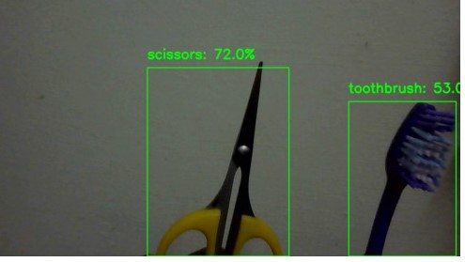
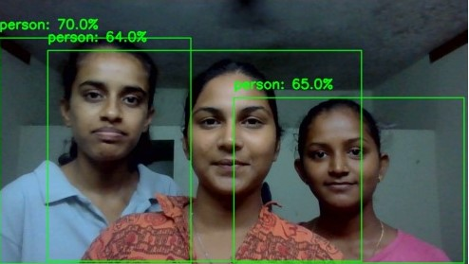
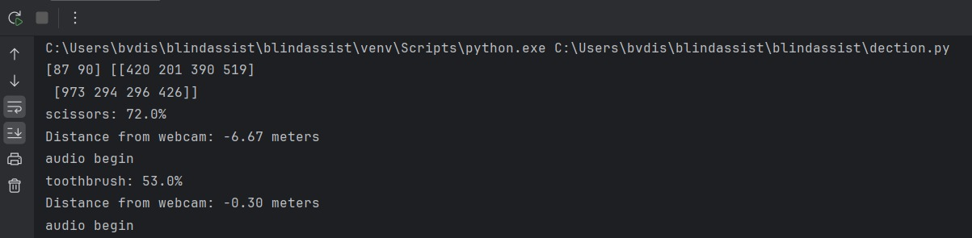
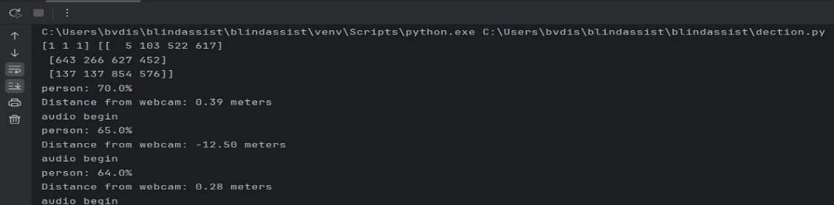
Results
Results of Object Detection module
Output 1
Output 2
Output 1 shows the object detection of scissors and toothbrush with its corresponding accuracy and also the audio output of the same.
Output 2 shows the object detection of persons with their corresponding accuracy and also the audio output of the same.
DEPT OF CS&E

Slide 21
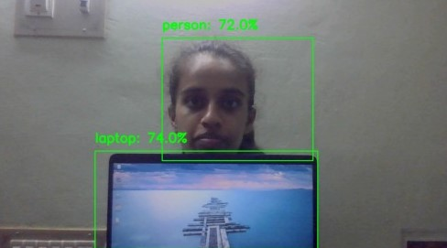
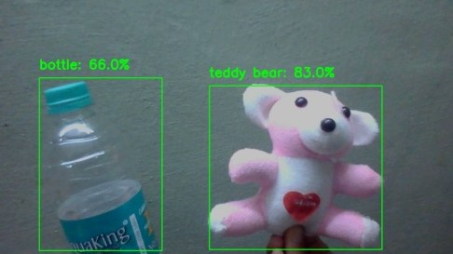
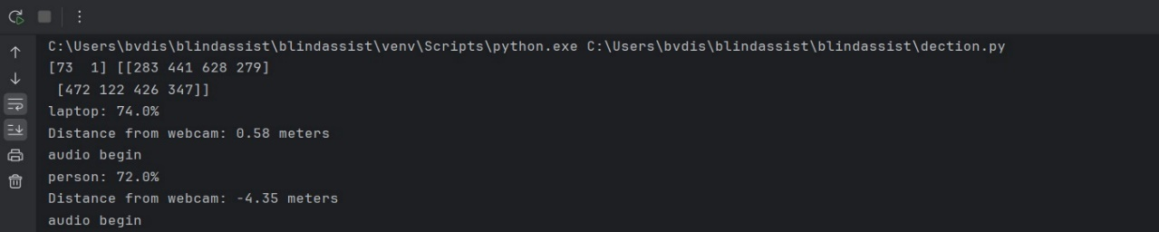
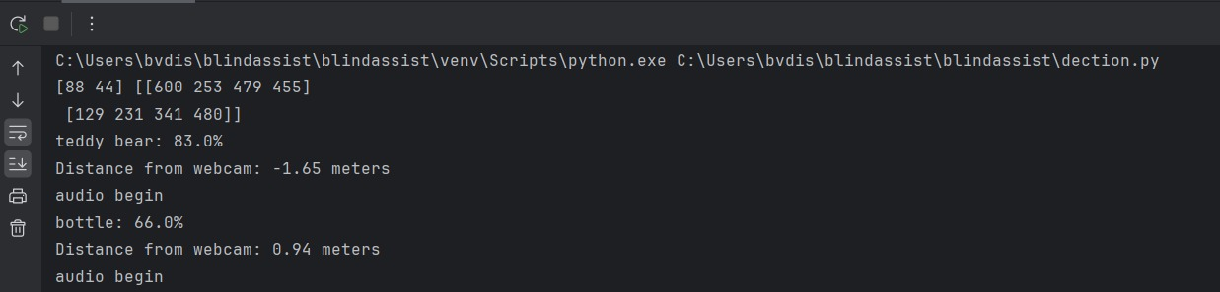
Continued..
Output 3
Output 4
Output 3 shows the object detection of person and laptop with its corresponding accuracy and also the audio output of the same.
Output 4 shows the object detection of bottle and teddy bear with its corresponding accuracy and also the audio output of the same.
DEPT OF CS&E

Slide 22
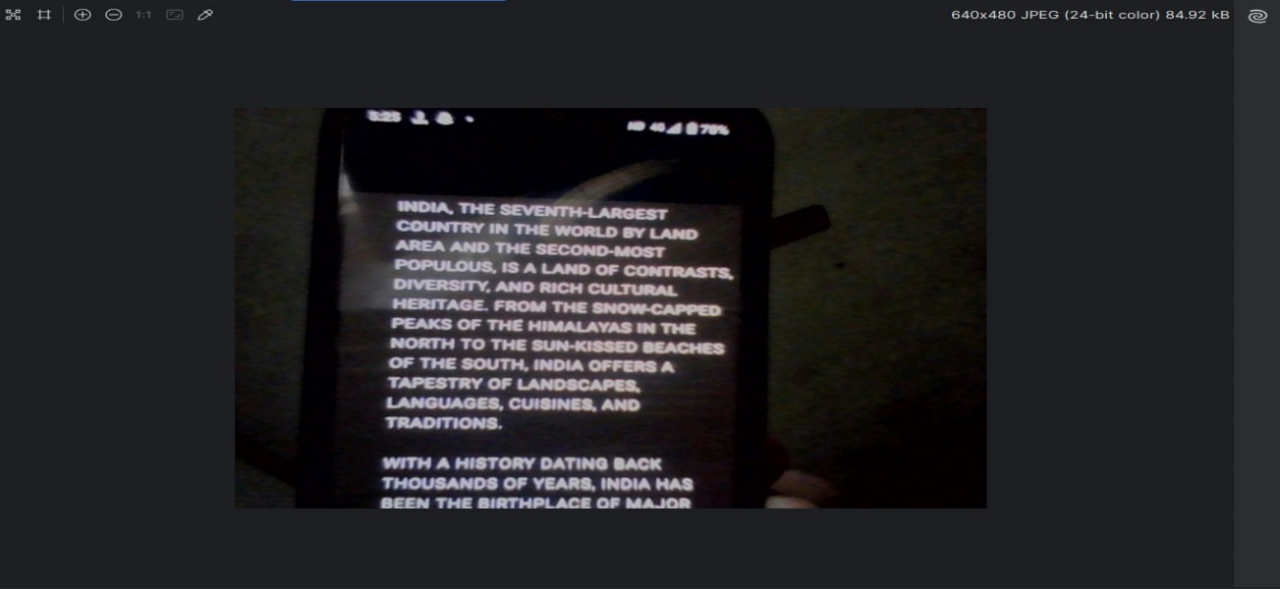
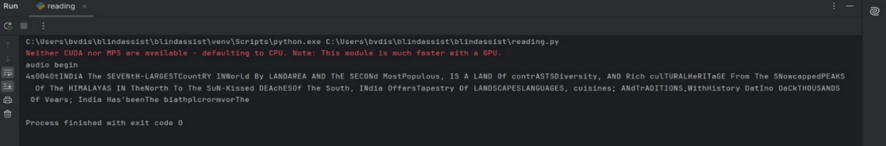
Results of Reading Module
Output 5
Output 5 represents the outcomes of reading module, shows the text output. Audio output also will generate.

Slide 23
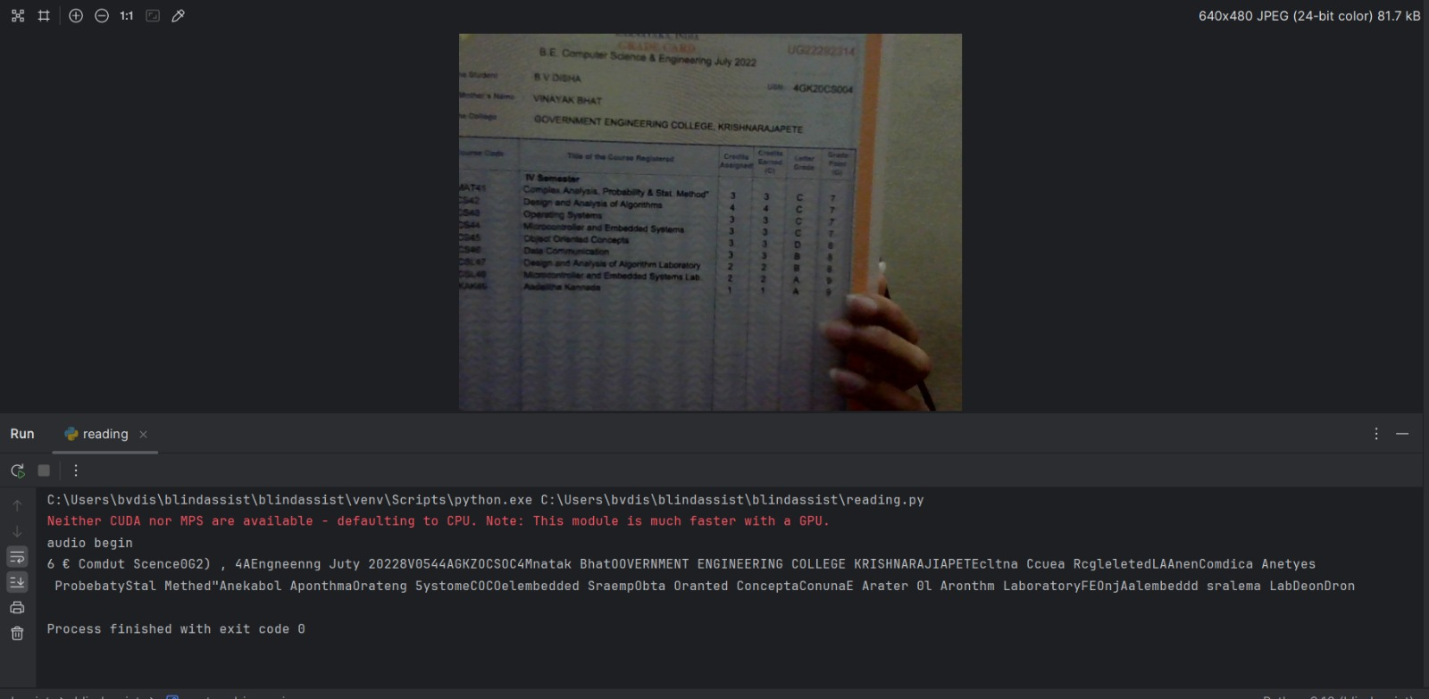
Continued..
Output 6
Output 6 represents the outcomes of reading module, shows the text output. Audio output also will generate.

Slide 24
Conclusion and Future Scope
By seamlessly integrating advanced computer vision and image processing technologies, the project empowers users to navigate their surroundings confidently through real-time object identification.
Moreover, the innovative inclusion of a book reading capability, supported by optical character recognition and text-to-speech functionalities, opens new avenues for autonomous access to written content.
Future Scope
Enhanced Object Detection Accuracy
Expanded Object Categories
Improved Book Reading Experience
Integration with Wearable Devices
DEPT OF CS&E

Slide 25
References
[1] Rajani Suryakant Kolhe, Kajal Gajanan Dhole, Pratibha Sampat Thakre, Priyanka Sohan Prasad,” Smart Stick for The Blind and Visually Impaired People”, International Journal of Scientific Research in Science, Engineering and Technology,pp.207-210,2021.
[2] “Object Detection and Recognition in Real Time Using Deep Learning for Visually Impaired People”, June 2022, International Journal of Electrical and Electronics Research 10(2):80-86, June 202210(2):80-86, DOI:10.37391/ijeer.100205
[3] “Real time object detection for visually challenged people using machine learning “Prof. Sneha A. Khaire1, Dhanraj Nikam2, Ajinkya Pawar3, Chaitanya Devkar4, Shubham Pagar5, international journal of progressive research in engineering management and science (IJPREMS)Vol.03, Issue 05, May 2023, DOI: https://www.doi.org/10.58257/IJPREMS31126
[4] “Real time object detection system for blind people” Prof. V.N. Nirgude*1, Shwetark Kadam*2, Arihant Lodha*3, Rushikesh Kadam*4, Anirudha Kurhe*5 International Research Journal of Modernization in Engineering Technology and Science (Peer-Reviewed, Open Access, Fully Refereed International Journal) Volume:05/Issue:05/May-2023.
DEPT OF CS&E

Slide 26
THANK YOU
DEPT OF CS&E

